Slide 1
Drawing Early-Bird Tickets: Towards More Efficient Training of Deep Networks
ICLR 2020
Citation count: 8
Haoran You, Chaojian Li, Pengfei Xu, Yonggan Fu, Yue Wang, Richard G. Baraniuk & Yingyan Lin∗
Xiaohan Chen & Zhangyang Wang∗
Notes:
基於Lottery Hypothesis，並找到一個更有效、更快能找到Ticket(Pruned Target Network)的方法

Slide 2
Motivation
Lottery Hypothesis claim that exist a smaller and outperform network
Iterative pruning costs time
It seems that lottery ticket fail while large learning rate
Notes:
相信大家都知道Lottery Hypothesis，給定任一神經網路θ，可以用Iterative Pruning的方式找出一個更小且Test Accuracy更高的網路，但有兩個缺點
Iterative Pruning 花時間
在訓練過程中使用大LR(0.1)，lottery ticket的test accuracy和用Random Initialize一樣(refer to Rethinking The Value of Network Pruning)

Slide 3
Background
Lottery Hypothesis
The limit of lottery hypothesis

Slide 4


Background
Lottery Hypothesis
A neural network $θ$ with initial parameters θ = $θ_{0}$ ∼ $D_{θ}$. When optimizing with SGD , it reaches minimum validation loss l at iteration j with test accuracy a . In addition, consider training ${m θ}_{0}$ with a mask m ∈ {0, 1} and optimizing with SGD on the same training set, it reaches minimum validation loss l’ at iteration j’ with test accuracy a’.
The lottery ticket hypothesis predicts that ∃ m for which j’ 0 ≤ j, a’ ≥ a , and ${\left\|m\right\|}_{2}$ < |θ| (fewer parameters).
Notes:
給定任一神經網路θ，Exist 一個神經網路θ'，及Mask m = {0, 1}，使 = m * θ，θ >> θ'，分別訓練神經網路θ' j' iteration、θ j iteration，在同量的(commensurate)且訓練量下j' <= j，神經網路θ, θ'可以達到Test Accuracy a, a'，且a' >= a

Slide 5
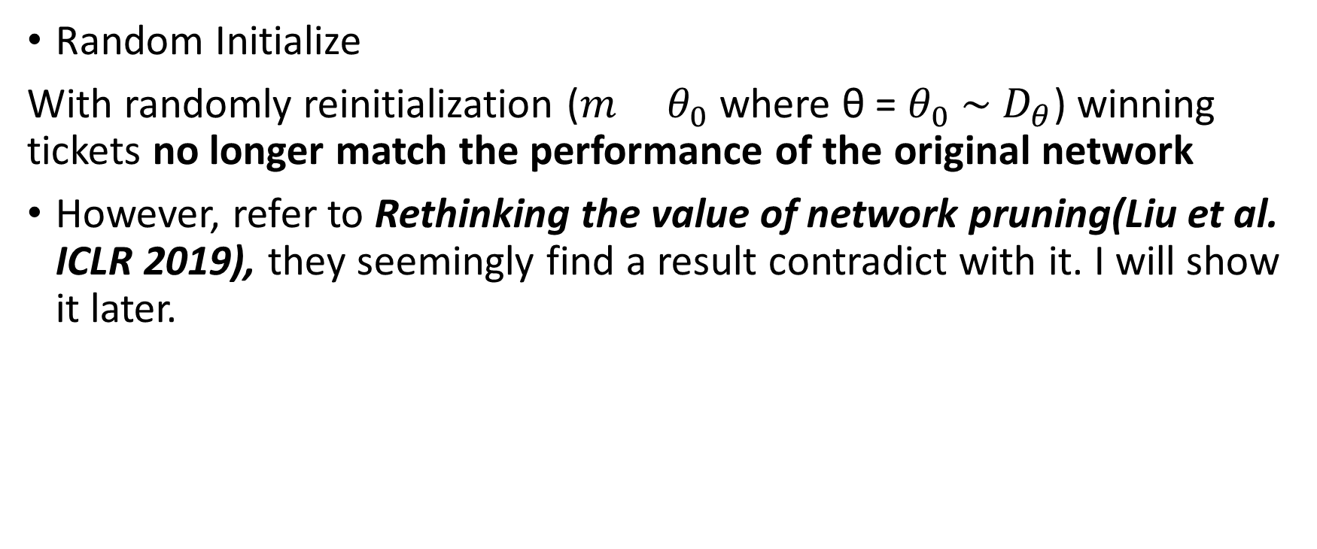
Background
Random Initialize
With randomly reinitialization (${m θ}_{0}$ where θ = $θ_{0}$ ∼ $D_{θ}$) winning tickets no longer match the performance of the original network
However, refer to Rethinking the value of network pruning(Liu et al. ICLR 2019), they seemingly find a result contradict with it. I will show it later.
Notes:
Random Intialize 不是本篇要解的問題，等這篇講完再說，點到為止

Slide 6
Problem formulation
Is there a more efficient training framework to get the lottery?

Slide 7
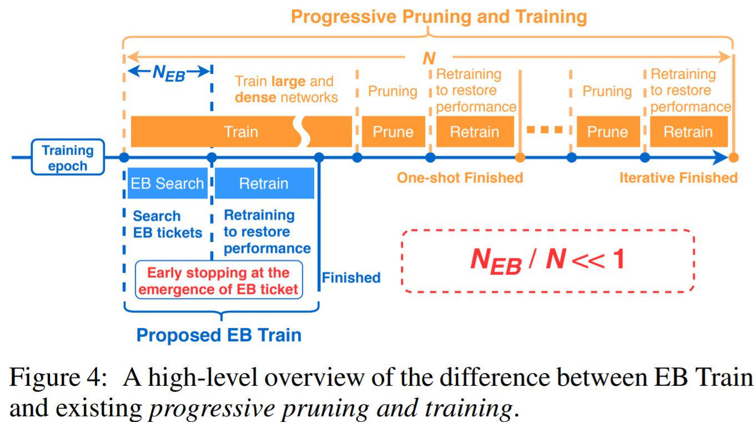
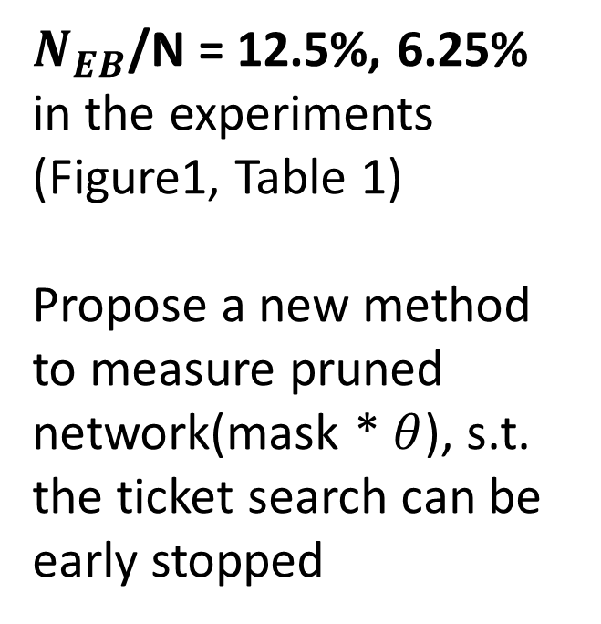
Early-Bird Ticket Algorithm
$N_{EB}$/N = 12.5%, 6.25%
in the experiments
(Figure1, Table 1)
Propose a new method to measure pruned network(mask * $θ$), s.t. the ticket search can be early stopped
Notes:
Measure pruned network的方法，使得它可以early stop(比one-shot還要更早的時候)(原本的大model還沒有train好的時候)就把subnetwork抓出來
如果要細說的話，傳統的Progressive Pruning或Lottery Ticket 需要多個Iteration才能Prune出target network，但是EB ticket只需要做一次Search然後retrain就可以完成，Search的epoch比one-shot lottery ticket更短，而整個過程只要原先Pruning作法的12.5%~6.25%，依據paper中的實驗的結果

Slide 8
Outline
Main Idea
Validation
Efficient Early-Bird Training & Experiments
Comparing with Lottery
Conclusion

Slide 9
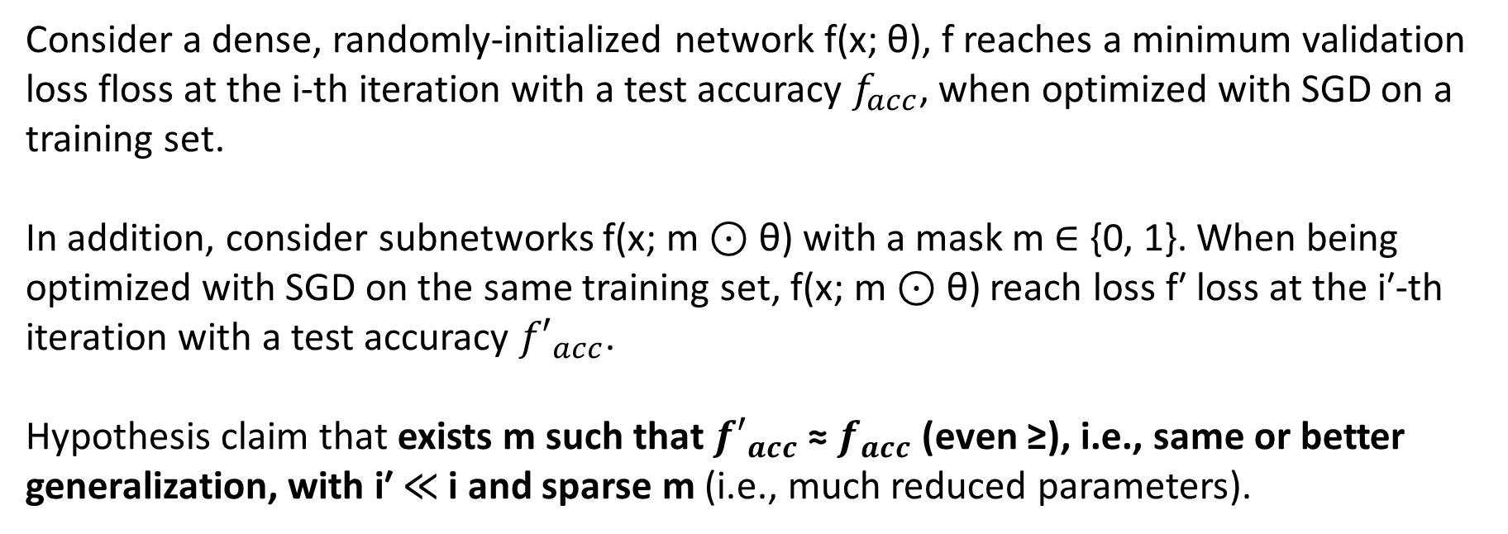
Main Idea
Early-Bird Ticket Hypothesis
Consider a dense, randomly-initialized network f(x; θ), f reaches a minimum validation loss floss at the i-th iteration with a test accuracy $f_{acc}$, when optimized with SGD on a training set.
In addition, consider subnetworks f(x; m ⊙ θ) with a mask m ∈ {0, 1}. When being optimized with SGD on the same training set, f(x; m ⊙ θ) reach loss f′ loss at the i′-th iteration with a test accuracy ${f′}_{acc}$.
Hypothesis claim that exists m such that ${f′}_{acc}$ ≈ $f_{acc}$ (even ≥), i.e., same or better generalization, with i′ ≪ i and sparse m (i.e., much reduced parameters).
Notes:
Mask: indicate pruned(0)和保留(1)
和lottery ticket hypothesis差不多，但是EB ticket強調的在於可以在非常早的時候就找出ticket，而且model的accuracy 和原model幾乎一樣
Subnetowrk = m * theta, mask denote the node discard(0) or keep(1)

Slide 10
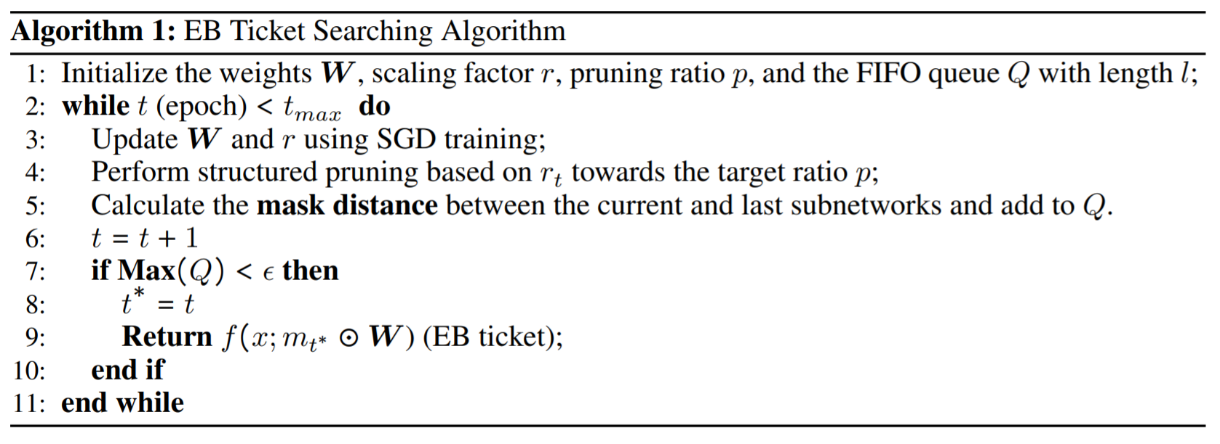
Main Idea
Implement Early-Bird Ticket
The pruning ratio p, length of queue and threshold Ɛ are hyperparameters
By default Ɛ = 0.1, l = 5
Notes:
Simply to say, the algorithm will train the original network with SGD and **prune the channels in *p%* virtually** to get the mask until **the mask distance < *Ɛ* which means the mask become stable.**
set the threshold Ɛ as 0.1 and the length of queue l as 5
Mask distance = difference of masks
The scaling factor *r* in batch normalization(BN) is a coefficient that mutiply with the weights of the network and it would be trained with SGD. The scaling
factor *r* can increase the magnitude of weight and make it easier to identify the neurons should be pruned. It also be uesd in the paper [*Learning Efficient Convolutional Networks through Network Slimming (Liu et al. 2017)*](https://arxiv.org/abs/1708.06519)
每次做virtual Prune，然後計算這次的mask和上次mask的distance，若distance < threshold就停止prune輸出EB ticket，那重要的其實就是mask distance怎麼測量

Slide 11
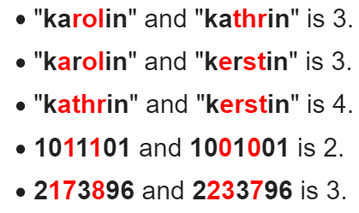
Main Idea
Measure mask distance by Hamming Distance
Which measuring the difference between 2 masks
Examples

Slide 12
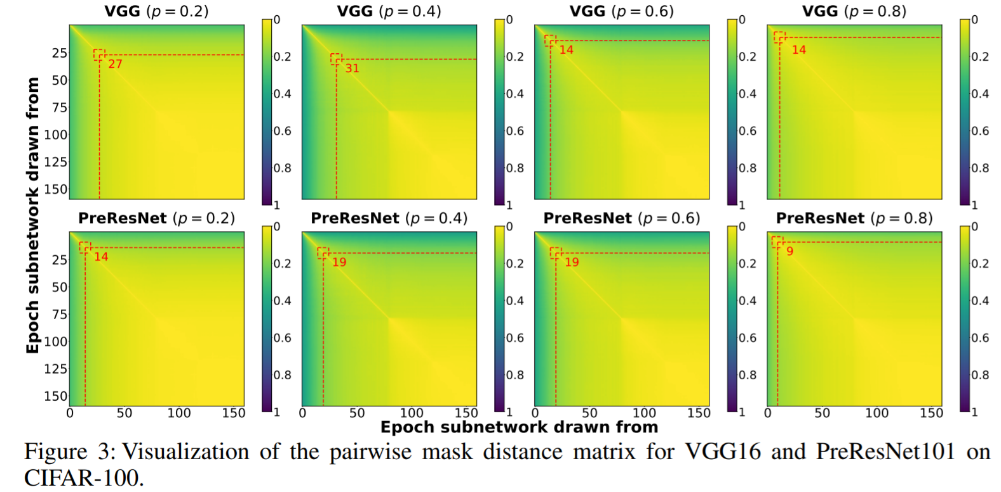
Validation
Visualize the distance of masks drawn from each epoch
X, Y axis are epochs that masks are drawn from. The red lines denote 0.1 in mask distance
Notes:
For the following figure, it shows the mask distance drawn from different epoch where **(i, j)-th element in the matrix denotes the mask distance in normalized(by the size of original network) between subnetwork drawn from i-th and j-th epochs.** The warmer, the closer. The red lines denote 0.1 in mask distance. It shows the masks of EB tickets are determined in a very early stage.
You can see

Slide 13
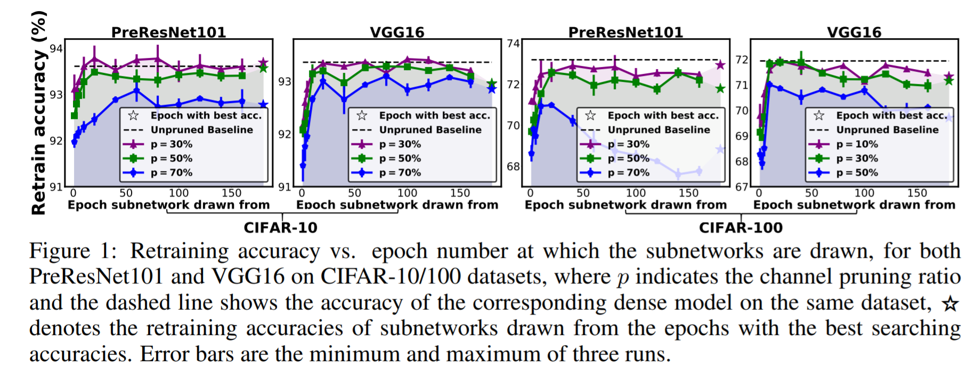
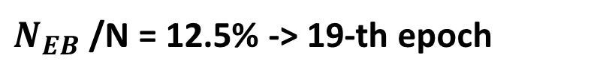
Validation
EB Tickets Emerge & Performance
$N_{EB}$/N = 12.5% -> 19-th epoch
Notes:
從每個epoch抽出EB ticket並retrain後的accuracy
一個round約150epoch，在地25 epoch就可以得到EB ticket

Slide 14
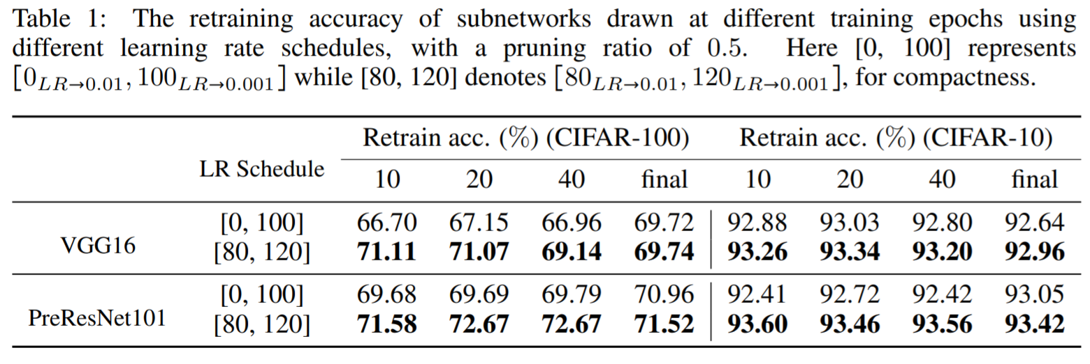
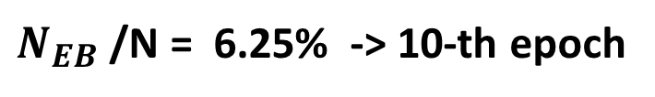
Validation
Learning Rate & Performance
Pruning Rate
$N_{EB}$/N = 6.25% -> 10-th epoch
[80, 120] means that starting from 0.1, decay to 0.01 at 80-th epoch and further decay to 0.001 at 120 epoch
Notes:
在Learning Rate比較大的時候，accuracy則比較大

Slide 15
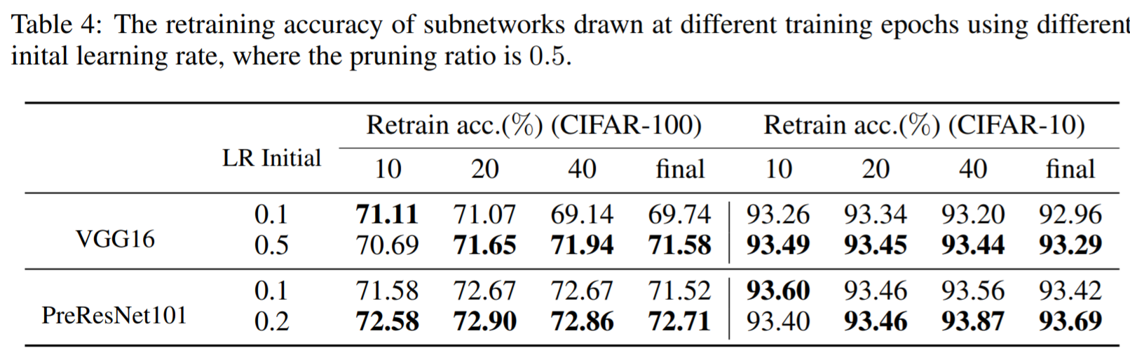
Validation
Learning Rate & Performance
Pruning Rate
0.5 means that starting from 0.5, decay to 0.01 at 80-th epoch
and further decay to 0.001 at 120 epoch
Notes:
LR 更大

Slide 16
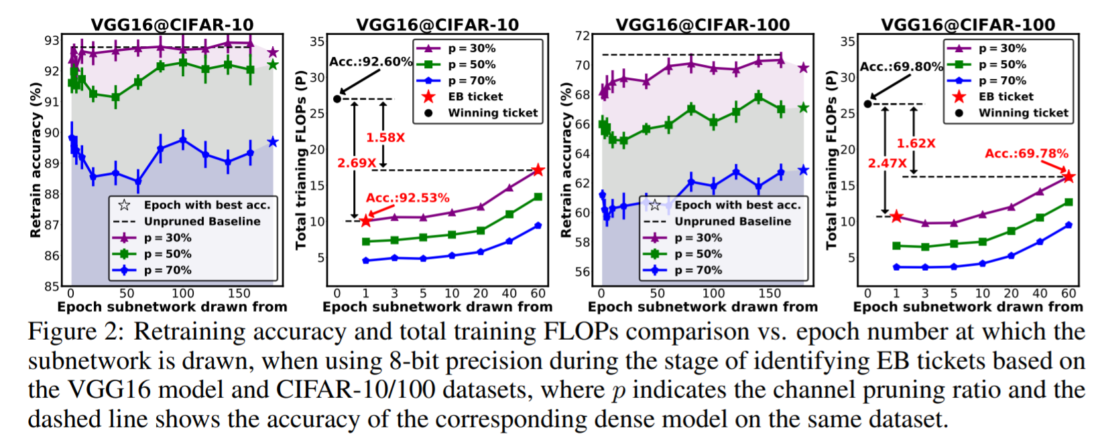
Validation
Precision & Performance & Total Training FLOPs
Ticket search in 8 bits + Retrain in 32 bits full-precision
Notes:
Low precision doesn’t hurt EB ticket，but save much computation cost

Slide 17
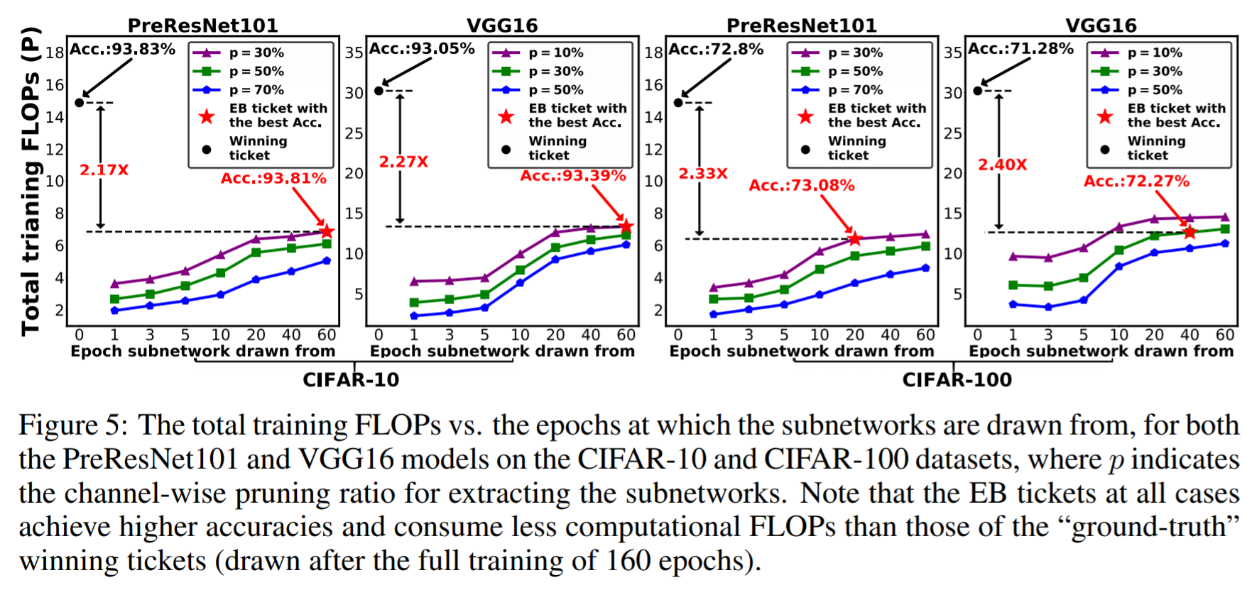
Validation
Precision & Performance & Total Training FLOPs
Ticket search in 8 bits + Retrain in 32 bits full-precision

Slide 18
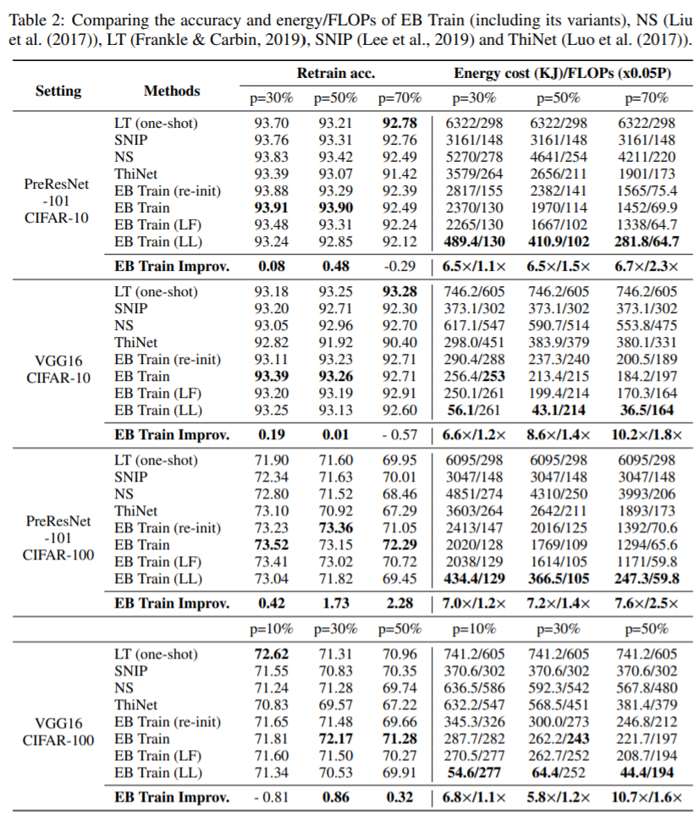
Experiments
 | Ticket Search | Retrain
LF | 8 bits | 32 bits
FF | 32 bits | 32 bits
Re-init | Retrain from a new random initialization
Notes:
把各種Pruning Method拿出來比，EB 幾乎跟lottery ticket test accuracy 沒差太多，但FLOP Computation cost則減少一到兩倍之多

Slide 19
Conclusion
The pruning result has been determined in very early stage
The precision of weight doesn’t matter
It seems that retraining from random initialization doesn’t hurt the performance of EB ticket
The learning rate used here is much larger than lottery tickets

Slide 20
Learning Rate Matters

Slide 21
Rethinking the value of network pruning
ICLR 2019
Citation count: 263
Zhuang Liu, Mingjie Sun, Tinghui Zhou, Gao Huang, Trevor Darrell
Notes:
把很多的pruning method做一個整合性的比較，基本上很多結論的confirm了lottery ticket的結果
就主要只講Lottery Ticket 與不同的結果，其他實驗掠過

Slide 22
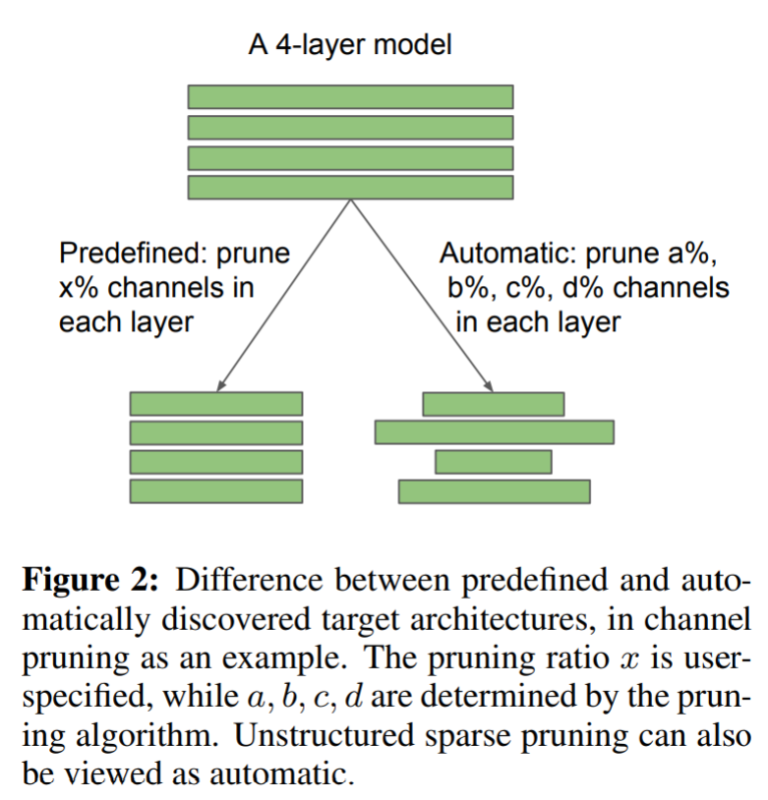
Structured Pruning & Unstructured Pruning
Structured Pruning:
Predefine p% pruning rate(pruned nodes / all nodes) for each layers
Unstructured Pruning:
Prune with different pruning rate(for each layers automatically
(Lottery Ticket)

Slide 23
Settings of Experiment on Lottery Ticket
Compare the result of structured pruning method, despite for Lottery Ticket only evaluates on unstructured pruning.
Relatively large modern models VGG16, ResNet50 used in the original pruning method than Lottery Ticket
Use momentum SGD with a large initial learning rate (0.1), while Lottery Ticket only use much smaller ones
Include the large-scale ImageNet dataset while Lottery Ticket only considers MNIST and CIFAR

Slide 24
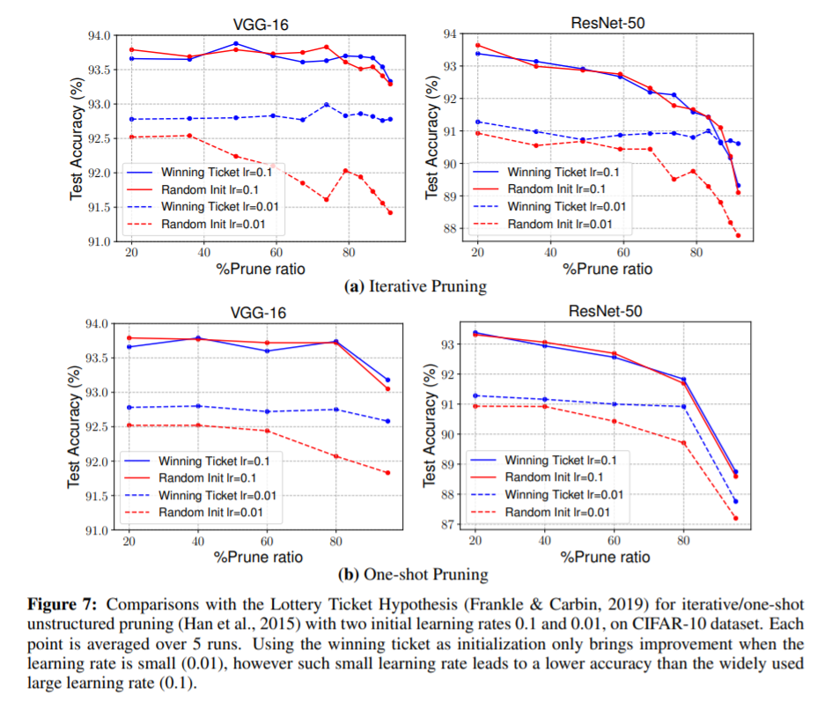
Unstructured Pruning
1. With large learning rate, performance of random initialization and lottery ticket are close
2. Using the original initialization as in Lottery Ticket only provides advantage over random initialization with small initial learning rate 0.01
Notes:
在非結構化剪枝(Unstructured Pruning)中，
LR(Learning Rate)較大的時候(0.1)，Lottery Ticket相比於Random Init沒有太多優勢。
如果LR(Learning Rate)較小(0.1)，結果誠如Lottery Hypothesis所言，Lottery Ticket 確實比Random Init好。但是在小LR的狀況下，無論是Lottery Ticket和Random Init結果都比大LR的結果差

Slide 25
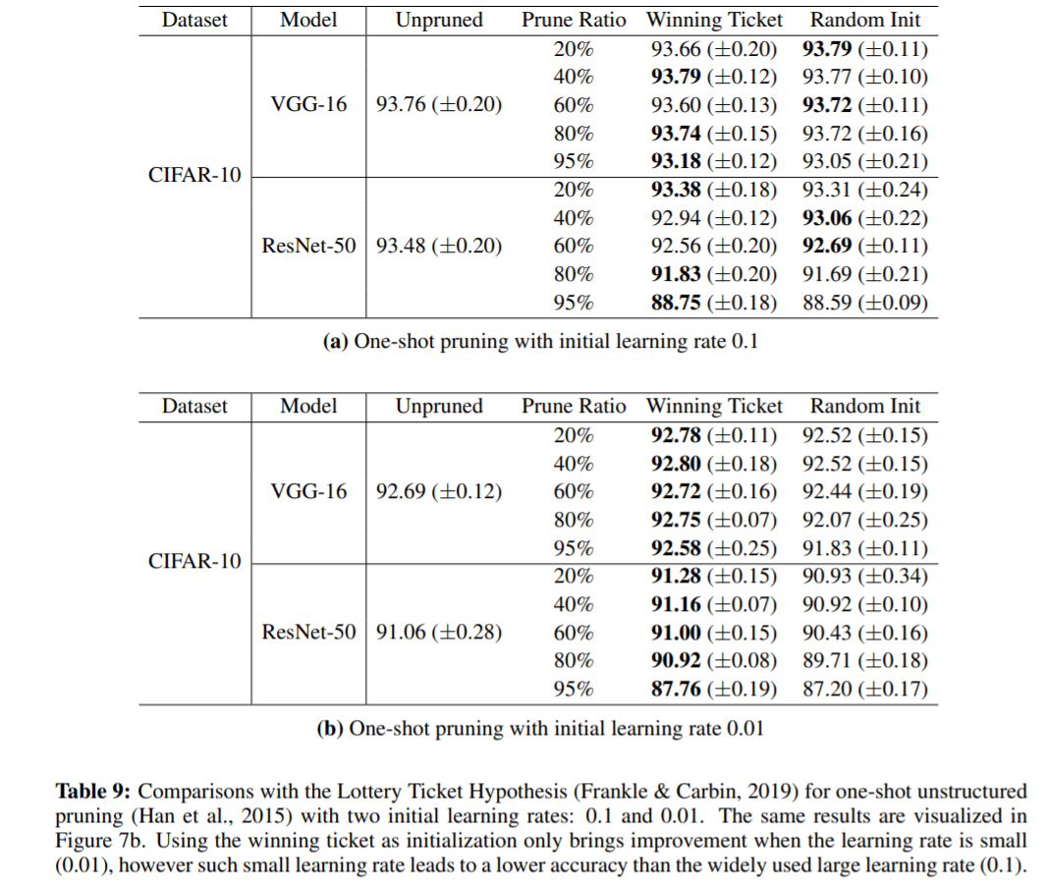
Unstructured Pruning
1. With large learning rate, performance of random initialization and lottery ticket are close
2. Using the original initialization as in Lottery Ticket only provides advantage over random initialization with small initial learning rate 0.01
Notes:
在非結構化剪枝(Unstructured Pruning)中，LR(Learning Rate)較大的時候(0.1)，Lottery Ticket相比於Random Init沒有太多優勢。如果LR(Learning Rate)較小(0.1)，結果誠如Lottery Hypothesis所言，Lottery Ticket 確實比Random Init好。但是在小LR的狀況下，無論是Lottery Ticket和Random Init結果都比大LR的結果差

Slide 26
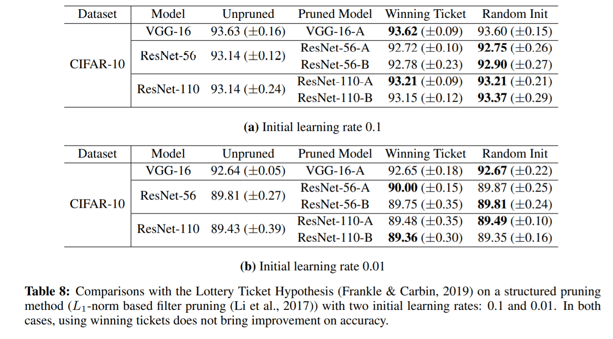
Structured Pruning
For structured pruning, Lottery Ticket doesn’t outperform random initialization
Notes:
而在結構化剪枝(Structured Pruning)中，Lottery Ticket並不會帶來比Random Init更好的Test Accuracy

Slide 27
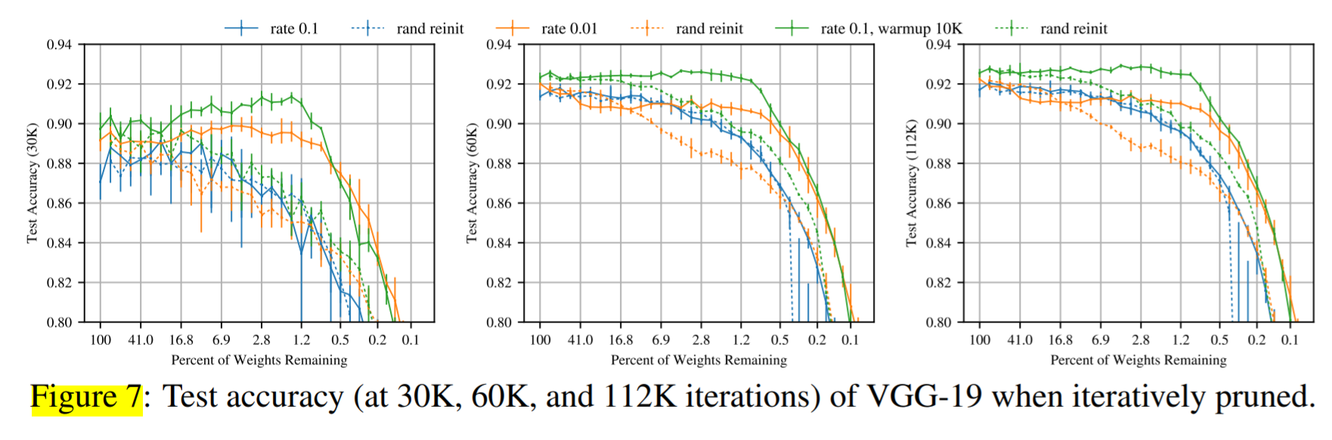
Confirm by Lottery Hypothesis
1. Doesn’t outperform but the pattern still emerge
2. Training VGG-19 with warmup (k = 10000) improves the test accuracy
Learning Rate 0.1
Notes:
Confirm by lottery hypothesis，as for large LR(0.1), 兩條線確實很接近(藍)，但在小LR時，winning ticket確實outperform random initialize，但是值得注意的是小LR outperform 大LR，為了improve大LR，使用warm up

Slide 28
Hypothesis
Confirm by Lottery Hypothesis
Highly overparameterized networks can be pruned, reinitialized, and retrained successfully
Less severely overparamterized networks only maintain accuracy with fortuitous initialization.
Notes:
我們假設，在一定程度的稀疏性之前，可以成功修剪，重新初始化和重新訓練高度過度參數化的網絡。但是，到此為止，經過高度修剪，不太嚴重的過度參數化的網絡只能通過偶然的初始化來保持準確性。

Slide 29
Conclusion
The lottery ticket only brings improvement in the case of unstructured pruning, with small initial learning rate, but this small learning rate yields inferior accuracy compared with the widely-used large learning rate.
For structured pruning, training the small target model from random initialization can achieve the same performance of unpruned model
Notes:
Weight不重要
Architecture重要
Initialization有爭議

Slide 30
End

Slide 31
Background
Rethinking the value of network pruning(Liu et al. ICLR 2019).
They found the winning ticket only brings improvement in the case of unstructured pruning, with small initial learning rate, but this small learning rate yields inferior accuracy compared with the widely-used large learning rate.
Notes:
因為這個結論和EB ticket沒太大關係，所以詳細的實驗放到後面說明
但是這幾篇一起看的話會還蠻有趣的，所以放上來講

